Slide 1
CVE Common Vulnerabilities and Exposure

Slide 2
CVE is a international standard for publicly disclosed computer security flaws in a uniform and standard convention across all language barriers

Slide 3

CVE Background
Created in 1999 by MITRE none profit organisation funded by the US.
Created to unify multiple vulnerability database from many services and advisory’s.
Think of it as a dictionary of vulnerabilities with a id.
Previously most cybersecurity tools used their own databases and their own names for vulnerabilities. Because the available products varied so widely, it was hard to figure out when different databases were referring to the same issue
CCS 6004
=
XF 415
=
CA-96.08
Mitre manages federally funded research and development centres supporting various U.S. government agencies in the aviation, defence, healthcare, homeland security, and cybersecurity fields, among others

Slide 4
Structure
CVE provides a common naming scheme for vulnerabilities, this allows for quickly finding and referencing the vulnerabilities.
Examples of CVE are:
CVE-1999-0001
CVE-2001-1111
CVE-2021-44228
44228
CVE-
2021-
Identical Prefix
Publication Year
Sequence number

Slide 5
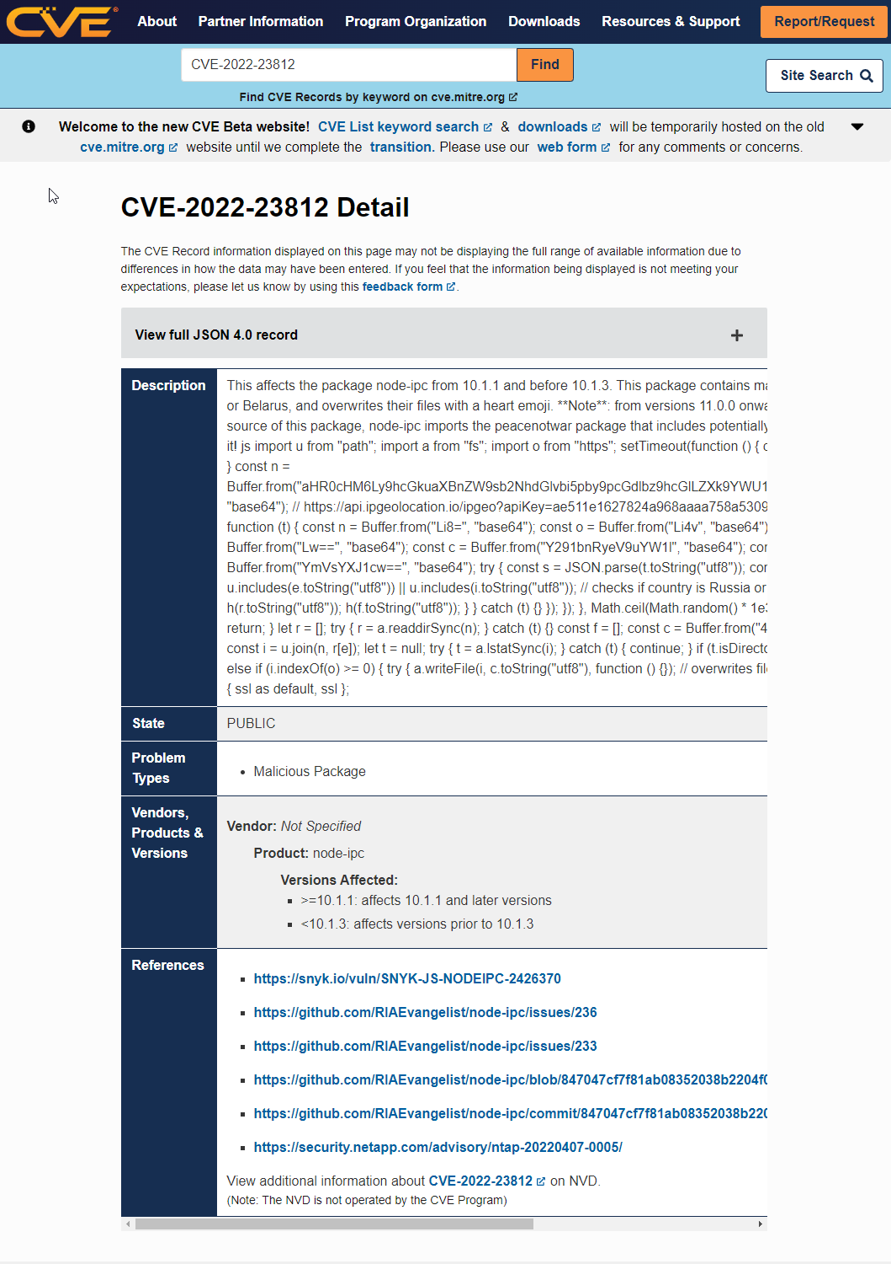
Important information
Note this is the view in the new CVE site as of 2022.
CVE – ID
Description
Vendors, Product and Versions Affected
References
Third party sites you can go to find additional resources
Shows the vendors, products and version effected by this vulnerability.
This is a standardized text description of the issue.
Unique ID
https://www.cve.org/CVERecord?id=CVE-2021-44228

Slide 6
Well Known Examples
“CVE-2010-2772” Stuxnet
“CVE-2017-0114” WannaCry
“CVE-2021-44228” Log4Shell
“CVE-2022-23812” Node-IPC

Slide 7
Where do CVE ID’s come from
CVE ID’s will be assigned to vulnerabilities from CNA’s ‘CVE Numbering Authorities’
What is a CNA?
CNA is an organization responsible for the regular assignment of CVE IDs to vulnerabilities, and for creating and publishing information about the Vulnerability in the associated CVE Record. Each CNA has a specific Scope of responsibility for vulnerability identification and publishing.
Organization Types are
Bug Bounty Programs
Hosted Services
Vendors and Projects
Vulnerability Researcher(s)
214 CNAs As of April 2022
Airbus
Microsoft Corporation
Vmware
Synopsys
HackerOne
National and Industry CERTs:
Performs incident response and vulnerability disclosure services for nations or industries. They may assign CVE IDs as part of their role and scope.
Assigns CVE IDs to bug bounty vulnerability findings.
Assigns CVE IDs for vulnerabilities found in their own services.
Assigns CVE IDs for vulnerabilities found in their own products and projects.
Assigns CVE IDs to products and projects upon which they perform vulnerability analysis.
Synk
Apple
Dell
Cisco

Slide 8
NVD National Vulnerability Database

Slide 9
NVD Takes the information from CVE and enriches it with a Score, Category and Affected products

Slide 10

NVD Background
The U.S. National Vulnerability Database (NVD) was launched by the National Institute of Standards and Technology (NIST) in 2005
Public and free to use
The CVE List feeds NVD, which then builds upon the information included in CVE Records to provide enhanced information for each record such as fix information, severity scores, and impact ratings. As part of its enhanced information, NVD also provides advanced searching features such as by OS; by vendor name, product name, and/or version number; and by vulnerability type, severity, related exploit range, and impact.
The National Institute of Standards and Technology is a physical sciences laboratory and non-regulatory agency of the United States Department of Commerce

Slide 11
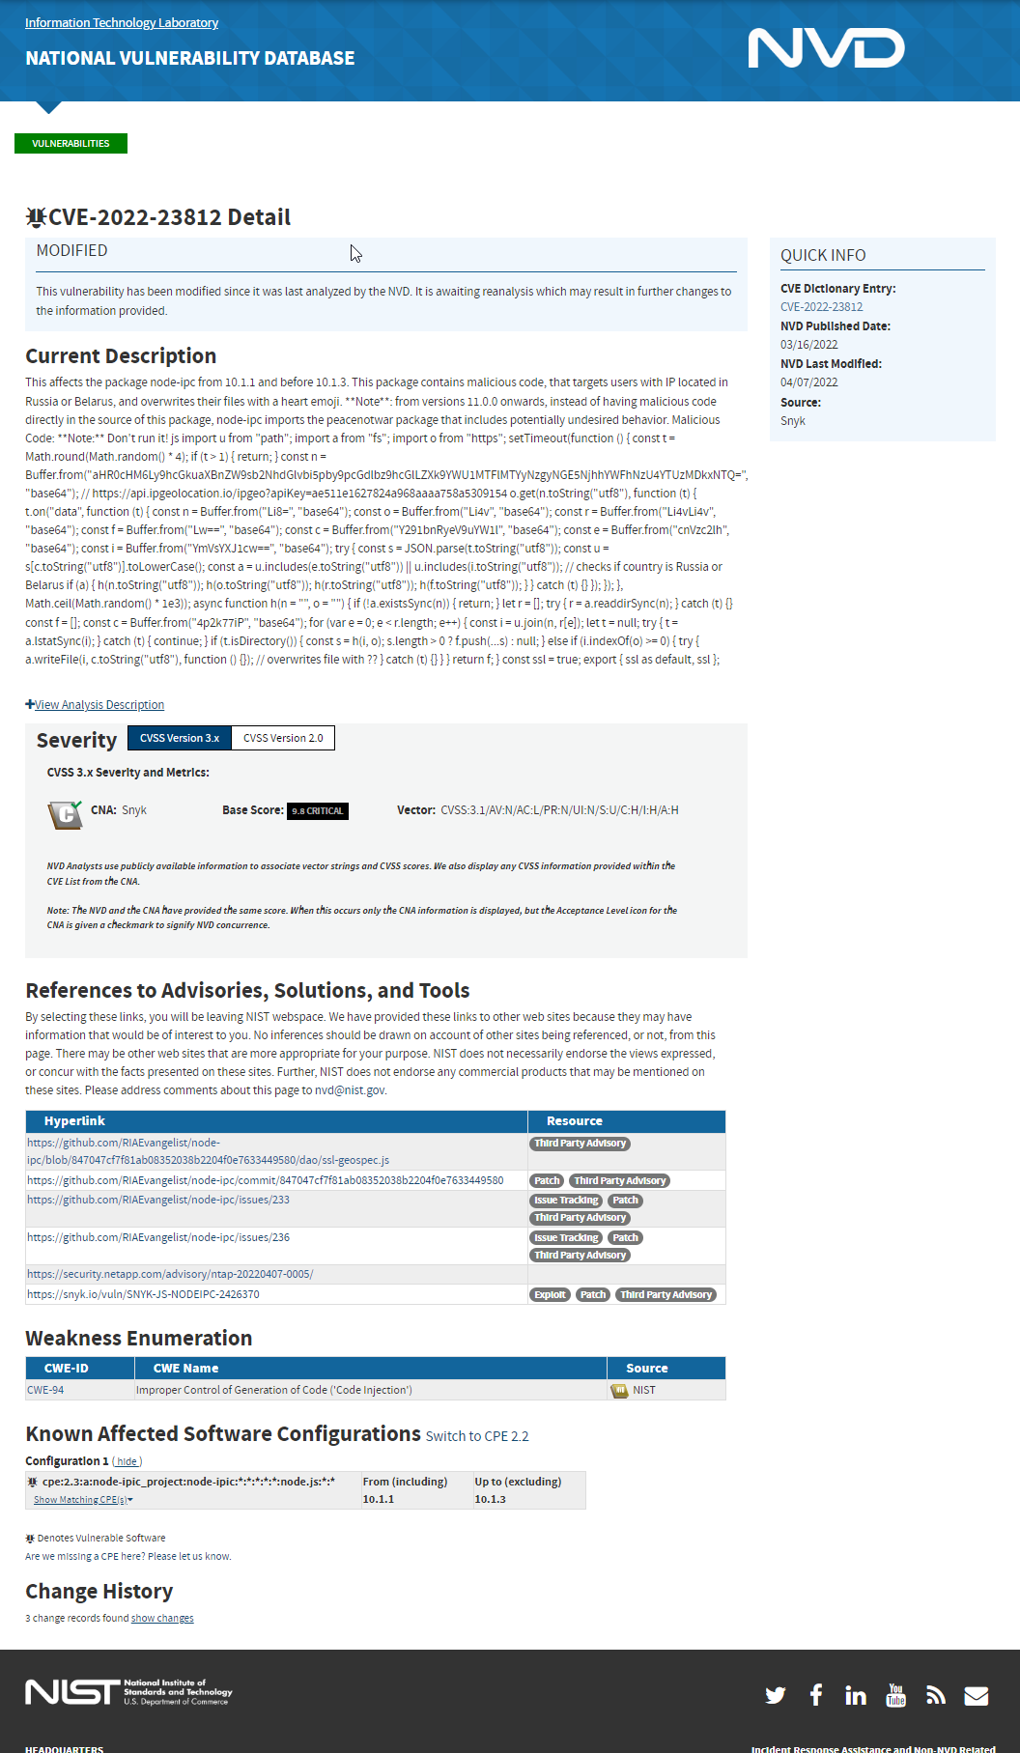
NVD
CVE – ID
Description
Severity
Scored (0.0 – 10.0) by the CVSS “Common Vulnerability Scoring System” Specification
(0.0) : None
(0.1 – 3.9) : Low
(7.0 – 8.9) : High
(9.0 – 10.0): Critical
(4.0 – 6.9) : Medium
This is a standardized text description of the issue.
Unique ID, Same as the CVE site
https://nvd.nist.gov/general

Slide 12
NVD
References
Known Affected Software Configurations
Link to interesting reads about the vulnerability
Tagged with what type of resource it is
EG: Patch, Exploit, Third Party Advisory
Shows where the vulnerability is present and which versions are effected
https://nvd.nist.gov/general

Slide 13
References
Search for CVE’s: https://cve.mitre.org/cve/search_cve_list.html
NVD Site: https://nvd.nist.gov/
MITRE: https://www.mitre.org/about/corporate-overview
Video: https://www.youtube.com/watch?v=nwsFEuCXyxI

